Slide 2
Document Database Schema Design

Slide 3
Agenda
Schema
Documents
Document Schema Design
Patterns
Notes:
on this section we will be discussing the main features of Java8
Lambda functions
New Date API

Slide 4
Schema

Slide 5
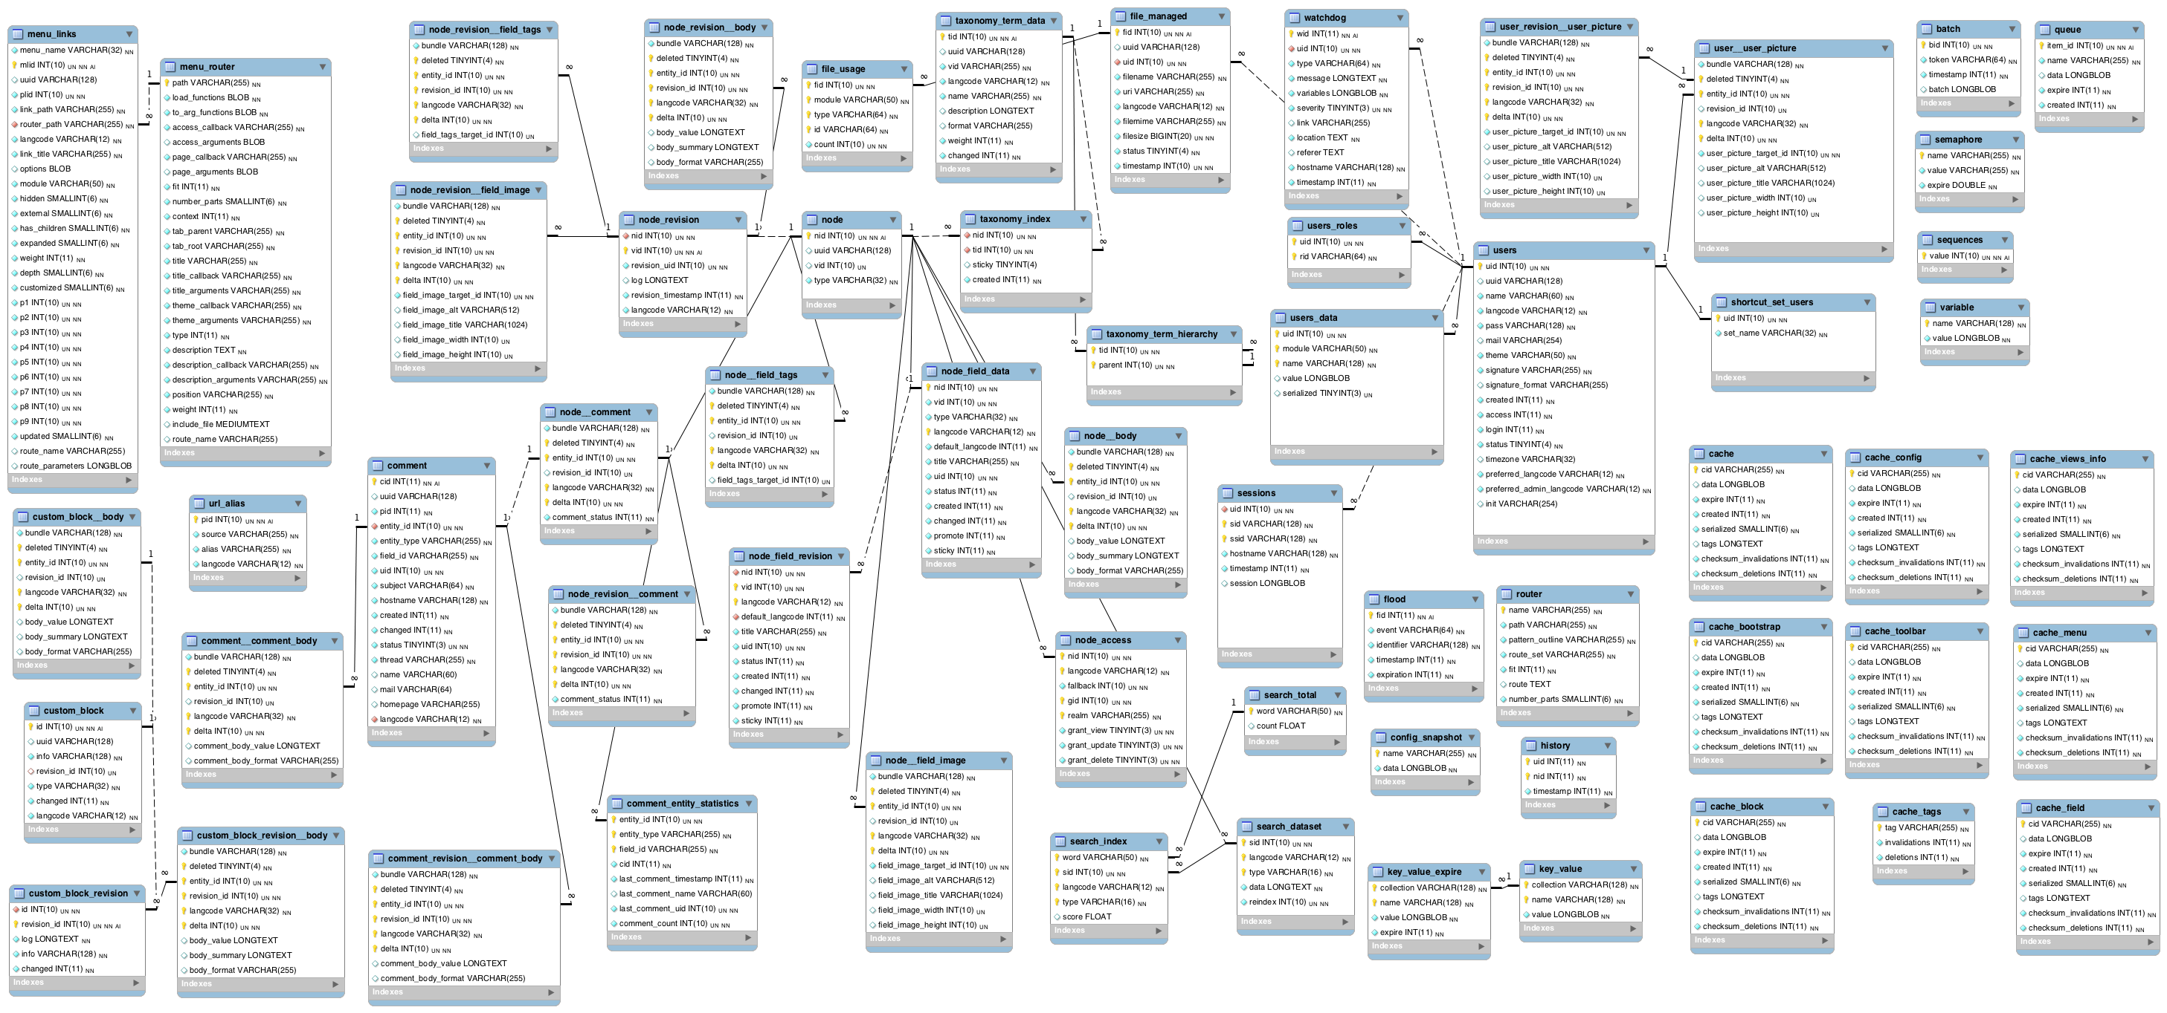
First thing that comes to mind…
Notes:
If you are an experienced software developer you've seen this picture over and over again.
This is the typical ERD that we produce so we can visualize our table spec.

Slide 6
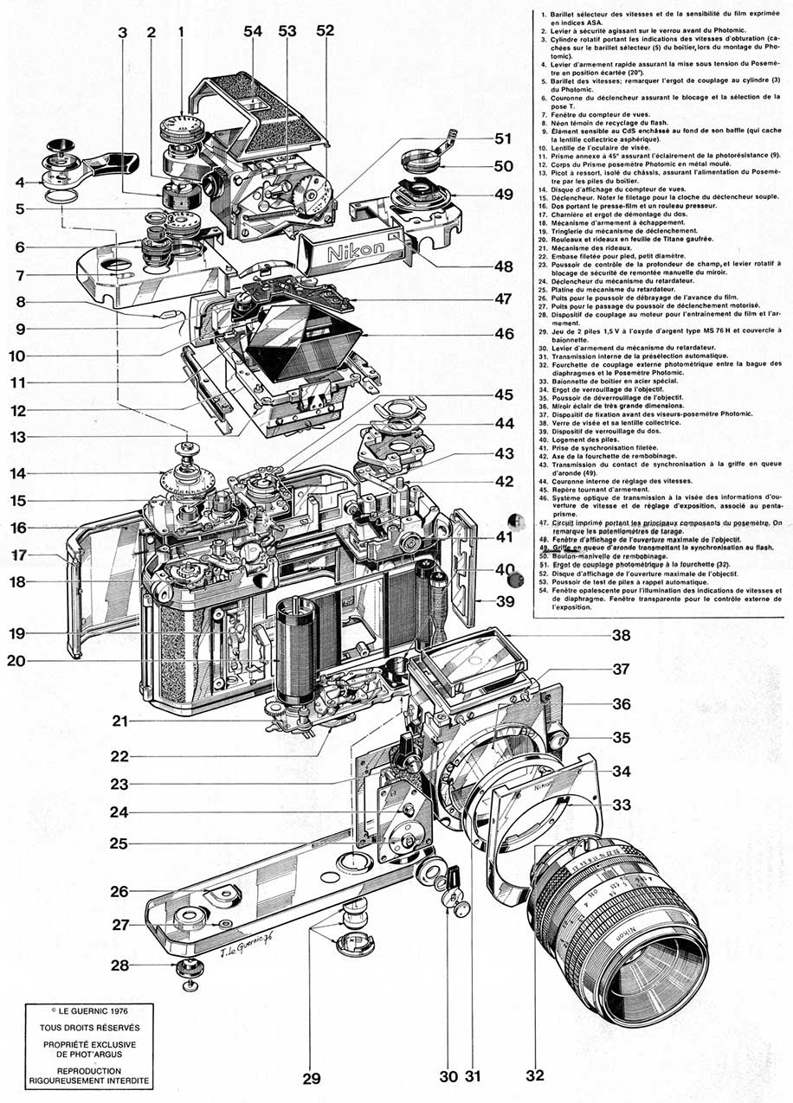

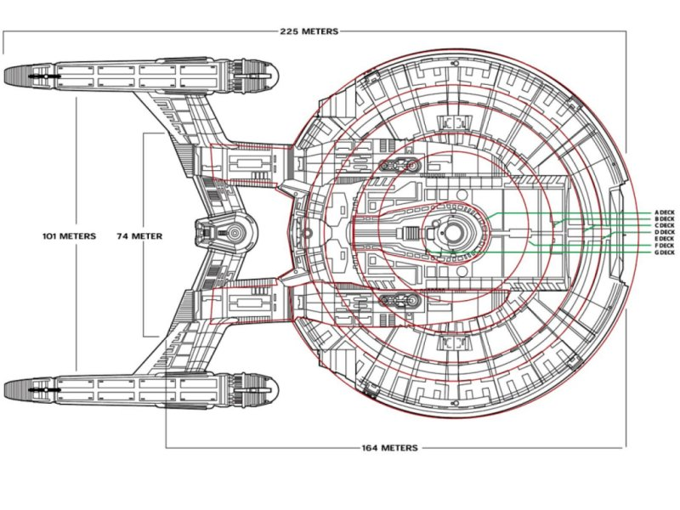
But there are other types of schema

Slide 7
Documents

Slide 8

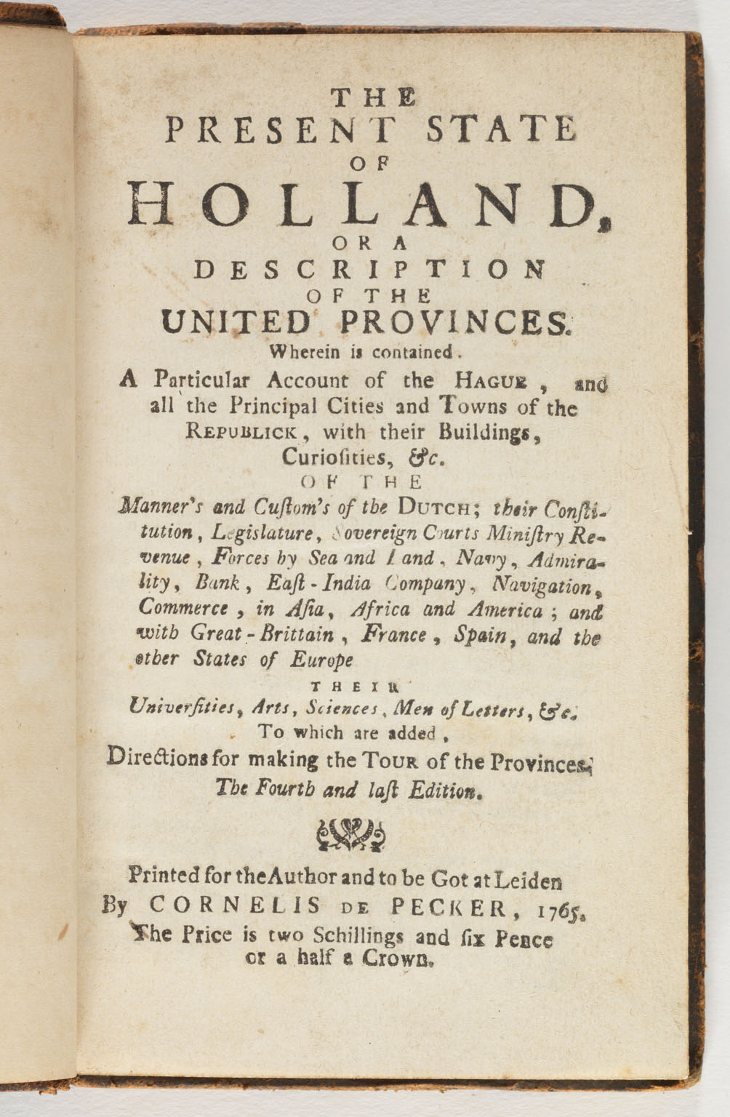


What is a Document?
{
name: ‘Dutch Constitution’,
headline: ‘The Present State of Holand’,
efforced_by: ‘King and Parliament’
date: ‘11 October 1848’,
labels: [legal, society, rules],
freedoms: [
{ name: ‘Speach’,
text: 'Any censorship is absolutely forbidden'},
{ name: ‘Association’,
text: 'This right can be limited by formal law,'},
}
}
Notes:
When we say documenter we are not referring to
Pdf files
Microsoft word documents
A document in MongoDB is a data structure composed by hierarchical key value pairs that form a piece of information.
These can be:
Python Dictionaries
PHP Array
Ruby HashMaps
JSON Objects
Etc
If one wants to, say define Holland's constitution we could use this json example

Slide 9
Document Schema Design

Slide 10






The focus is "What I want to Build"
We focus on how to use Data
Not on how to store it
Use flexibility of schema to adjust to new features and iterations deliver more features
Do not be restricted by the need to add functionality
Scale to accommodate your application data needs
Don't be afraid of being successful
Out of the Box Full features
Text Search
Geospatial, Rich queries
Map Reduce and Aggregation Framework
Notes:
In MongoDB we focus on the application purpose.
We are not restricted by the need of defining ahead how our data is going to be persisted on disk.
We change the line of though on
what we want to build?
How our app is going to be using information
What kind of operations are our users demand from our system

Slide 11
Mind Set
Application
Application
RELATIONAL WAY
MONGODB WAY
Notes:
On a pure relational system the application is build from the database schema upwards
While in MongoDB we focus on how the data is going to be used and then we persist.
The application models our data

Slide 12

It is so good it can take check-in's from Mars!

Slide 13
Patterns

Slide 14
Discrete Documents
{
policyNum: 123,
type: auto,
customerId: abc,
payment: 899,
deductible: 500,
make: Taurus,
model: Ford,
VIN: 123ABC456,
}
{
policyNum: 456,
type: life,
customerId: efg,
payment: 240,
policyValue: 125000,
start: jan, 1995
end: jan, 2015
}
{
policyNum: 789,
type: home,
customerId: hij,
payment: 650,
deductible: 1000,
floodCoverage: No,
street: “10 Maple Lane”,
city: “Springfield”,
state: “Maryland”
}
Notes:
There a different modeling patterns:
We can have discrete document usage.
Every single different object and element treated by the application will have it's discrete representation on the database
Being a flexible schema we can adjust not only in terms of data variability but also in terms of change management
Applications change faster and require new data
When we grow to certain size we might have problems iterating due to migrations and data management processes that are trimmed down by using MongoDB

Slide 15
Time Series
{
_id: "20130310/resource/home.htm",
metadata: {
date: ISODate("2013-03-10T00:00:00Z"),
site: "main-site",
page: "home.htm",
…
},
month : 3,
total : 9120637,
hourly: {
0 : 361012,
1 : 399034,
…,
23 : 387010 },
hour-minute: {
0 : { 0 : 5678,
1 : 6745,
2 : 9212,
…
59 : 6823
},
1 : { 0 : 8765,
1 : 8976,
2 : 8345,
…
59 : 9812
},
…
23 : { 0 : 7453,
1 : 7432,
2 : 7901,
…
59 : 8764
}
}
}
Notes:
In some other scenarios we need data to stored in a particular fashion to attend the type of data usage that application requires:
In timeseries use cases using discrete documents is not very efficient because it requires a constant growth of the database for each single input and constant aggregations to elaborate the plotting and graphs associated with the type of visualization required
For these use cases we tend to use a data format that reflects the application operations
Per unit of time we keep track of the metrics that occur in the system
We bucket that information in a pre-aggregated format so it's easier and faster to retrieve and update
We use in-place updates to make all writes extremely fast

Slide 16
Referencing vs Embedding
{
_id: 111,
name: "Friso",
beers: [
{ name: "SuperBock", comment: "AWESOME" },
{ name: "Bavaria", comment: "Boooohhhohoohoh"}
]
}
Embedding
{
_id: 111,
name: "Friso"
}
{
_id: 21,
user_id: 111,
name: "SuperBock",
comment: "AWESOME"
}
{
_id: 22,
user_id: 111,
name: "Bavaria",
comment: "Boooohhhohoohoh"
}
Referencing
Notes:
There's also the constant thrive between embedding or referencing | denormalizing vs normalizing data structures
In MongoDB the advantage is that to move from one particular data format to another is quite simple and requires very low impedance
Make sure you understand the tradeoffs
Faster access to data vs round trips to the database
Single point of data updates with referencing vs cascade updates for all documents that contain duplicated data

Slide 17
Referencing vs Embedding
Referencing | Embedding
Data grows in different ways | Want to retrieve all info in one go (avoid round trips to database)
Is access by different access patterns and workflows | Assure atomic operations
Have a different lifecycle | When data changes in the same rate and in the same pace

Slide 18
Anti-Patterns

Slide 19
Unbounded Arrays/Documents
{_id: 1, selfies: [x0001]}
db.profile.insert( doc0 );
db.profile.insert( doc2 );
{_id: 2, selfies: [x0101]}
db.profile.update({_id:1}, {$push:{selfies: x0202});
Notes:
We start with a small set of data for each array.
Then we decide push more info into those arrays, no problem we use the $push operator.

Slide 20
Unbounded Arrays/Documents
db.profile.insert( doc0 );
db.profile.insert( doc2 );
{_id: 2, selfies: [x0101]}
db.profile.update({_id:1}, {$push:{selfies: x0202});
{_id: 1, selfies: [x0001, x0202]}
Notes:
Moving occasionally documents is not a problem.
Moving all documents all the time has considerable perfromance implications since all documents will moving all the time

Slide 21
Unbounded Arrays/Documents
{_id: 3, selfies: [x0103…]}
db.profile.insert( doc0 );
db.profile.insert( doc2 );
{_id: 2, selfies: [x0101]}
{_id: 4, selfies: [x0104…]}
for i in all_profiles:
db.profile.update({_id: i}, {$push:{selfies: xXXX});
{_id: 1, selfies: [x0001, x0202]}
Notes:
Although MongoDB will try to efficiently occupy the $freelist space,
if we keep recurring the iteration around moving documents this will cause all documents to be constantly moving all the time.
Apart from slower operations this will also cause a large amount of fragmentation both on your indexes and in your collections structures.

Slide 22
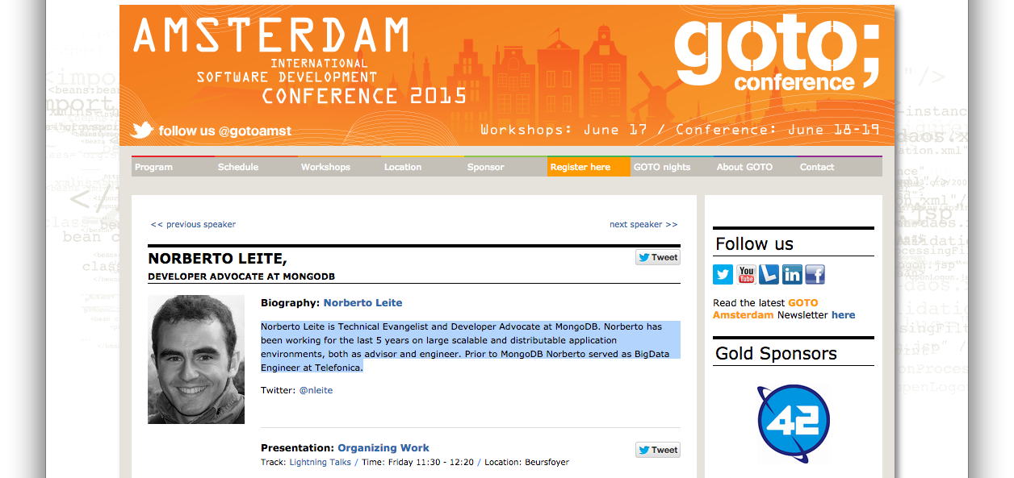
Overloaded Documents
Notes:
Let's take for example this page that describes the a conference speakers

Slide 23
Overloaded Documents
{
name: 'Norberto',
role: 'Technical Evangelist',
talks: [
{
title: 'Document Database Schema Design',
description:'This talk is a short introduction...',
schedule: '12:10 - 12:25'
},
{
title: 'Scalable Cluster in 15 minutes!',
description: 'This talk is a quick introduction...',
schedule: '14:50 - 15:05'}
]
twitter: 'nleite',
email: 'norberto@mongodb.com',
bio: 'Norberto Leite is Technical Evangelist...'
address: 'Calle Artistas, Madrid',
supporter: { clube: 'FC Porto', description: 'Best Club in the WORLD' }
conferences: ['GOTO', 'MongoDB World' ...],
git_activity: [{type: 'pr', hook:'3142ji3423j342'}],
selfies: [0x13423423423423, 0x13423434324234]
}
Notes:
If we want a complete profile of the user in one single document we can achieve that easily:
All it's information
Name
Profile
Bio
Description of the talk
- etc

Slide 24
Overloaded Documents
{
name: 'Norberto',
role: 'Technical Evangelist',
talks: [
{
title: 'Document Database Schema Design',
description:'This talk is a short introduction...',
schedule: '12:10 - 12:25'
},
{
title: 'Scalable Cluster in 15 minutes!',
description: 'This talk is a quick introduction...',
schedule: '14:50 - 15:05'}
]
twitter: 'nleite',
email: 'norberto@mongodb.com',
bio: 'Norberto Leite is Technical Evangelist...'
...
}
100% data usage
Notes:
But in reality what one actually uses are just a few fields of that profile.
These ones would correspond, for that given page 100% of all data needs

Slide 25
Overloaded Documents
0.1% data usage ?
...
address: 'Calle Artistas, Madrid',
supporter: { clube: 'FC Porto',
description: 'Best Club in the WORLD' }
conferences: ['GOTO', 'MongoDB World' ...],
git_activity: [{type: 'pr', hook:'3142ji3423j342'}]
selfies: [0x13423423423423, 0x13423434324234]
...
}
Notes:
The rest will probably be accessed 0.1% of the time.
Should we have all of it and access it all in one go?
With all the required indexes? All the burden of fetching all those extra pages that are not going to be consumed in the same requests?
Probably not.

Slide 26
Highly Nested Documents
{
name: 'Some Dude',
arguments: [
{
properties: [
{
fields: [
topics: {
a:1,
...
}
]
}
]
}
]
}
}
Please, don't go further than 5 levels!
Notes:
5 nesting document levels is not that bad but I would not go further than that:
Hard to maintain
Gigantic queries
Potential hitting limits on index entries and shard key sizes

Slide 27
Collection over-Normalization

Slide 28
Is it Easy?

Slide 29
Final Notes
Think on how you want your data to be used
Don't be afraid of making mistakes
It's normal (to normalize) and to make the first attempts with a relational mindset in place
Make use of the flexibility of schema do adjust or schema design
Talk to us if you need help!

